Slide 1
Disease Prediction (Machine Learning) Deepika (under the guidance of Mentorness)

Slide 2
Background
Healthcare professionals often rely on various diagnostic tests and biomarkers to assess an individual's health status and diagnose diseases. In this scenario, we have access to a dataset containing multiple health-related attributes such as cholesterol levels, blood cell counts, hormone levels, and other physiological measurements. The dataset also includes information on whether the individual has been diagnosed with a specific disease or not.

Slide 3
Objective
The objective of this project is to develop a predictive model that can accurately classify individuals into diseased or non-diseased categories based on their health attributes. By leveraging machine learning algorithms, we aim to create a reliable tool that healthcare providers can use to assist in disease diagnosis and prognosis.

Slide 4
Data Description
The dataset consists of the following attributes:
Cholesterol: Level of cholesterol in the blood (mg/dL)
Hemoglobin: Protein in red blood cells carrying oxygen
Platelets: Blood cells aiding in clotting
White Blood Cells (WBC): Immune system cells fighting infections
Red Blood Cells (RBC): Cells carrying oxygen
Hematocrit: Percentage of blood volume occupied by RBC
Mean Corpuscular Volume (MCV): Average volume of RBC
Mean Corpuscular Hemoglobin (MCH): Average amount of hemoglobin in RBC
Mean Corpuscular Hemoglobin Concentration (MCHC): Average concentration of hemoglobin in RBC
Insulin: Hormone regulating blood sugar levels
BMI (Body Mass Index): Measure of body fat based on height and weight
Systolic Blood Pressure (SBP): Pressure in arteries during heartbeats
Diastolic Blood Pressure (DBP): Pressure in arteries at rest between beats

Slide 5
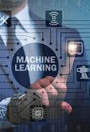
Data Analysis (predictive modelling)

Slide 6
Predictive modeling
A statistical method called predictive modeling is used to build a model that, given past data, can forecast future events. In order to find patterns and links in data and estimate future trends and behaviors, it entails applying a variety of algorithms and statistical techniques.
Applications
Finance: Stock price forecasting, fraud detection, and credit scoring.
Marketing: Forecasting revenue, predicting turnover, and segmenting customers.
Healthcare: Risk assessment for patients, disease prediction.
Manufacturing: Demand forecasting and predictive maintenance.
Retail: Personalized suggestions and inventory control.

Slide 7
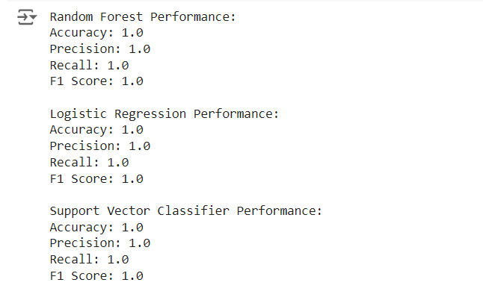
Random forest,logistic,svc

Slide 8
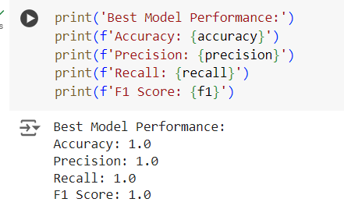
Random forest Classifier

Slide 9
CONCLUSION
The ultimate goal is to develop a robust predictive model that can assist healthcare professionals in early disease detection and patient management. By accurately identifying individuals at risk of certain diseases, interventions can be initiated promptly, potentially improving patient outcomes and reducing healthcare costs

Slide 10
Thank you

